Slide 1
COEN 345 Image Search Engine
Gautham J
Niharika Patil

Slide 2
Text based image search engines like Google Images, Bing, Flickr are based on key word searches based on tags.

Slide 3
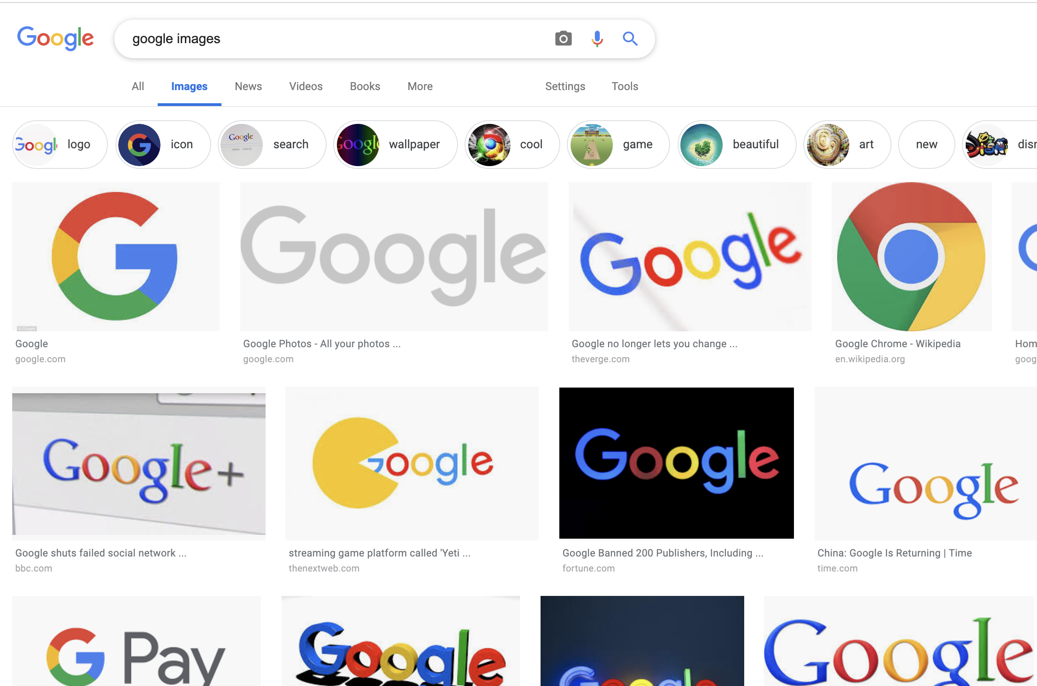
Image Search Engine

Slide 4
Our Approach
We give an image as an input to our search engine and this gives relevant images as output.
Our Approach is based on converting the image into a feature vector and then use it to query on our database of feature vectors based on similarity measures.

Slide 5
How to get features?
Use image descriptors method is also called (white box algorithms)
Or use neural nets(black box algorithms)
We are using image descriptors

Slide 6
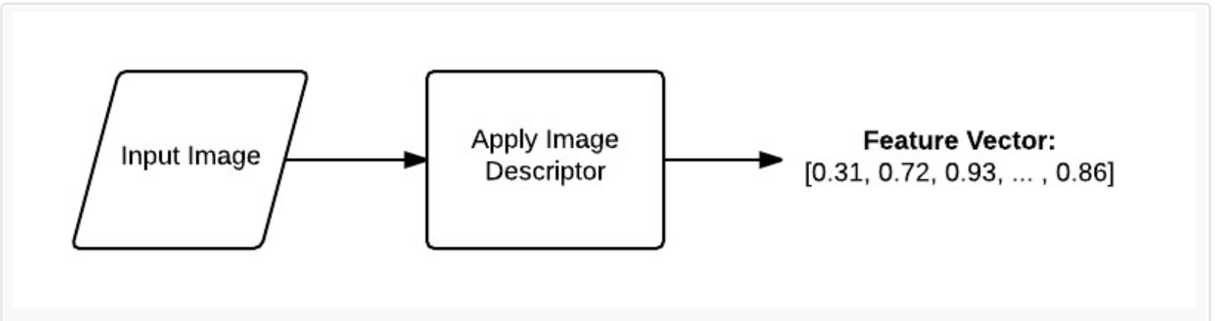
What is a descriptor?

Slide 7
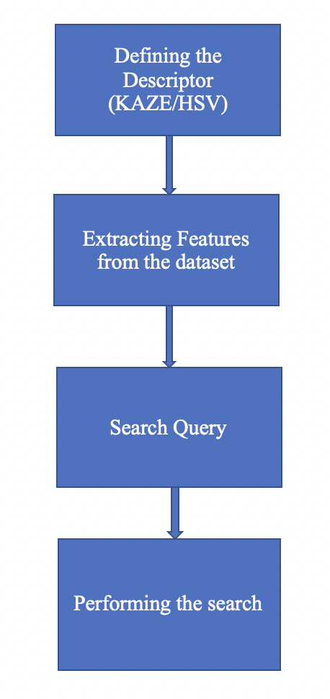
Our Approach

Slide 8
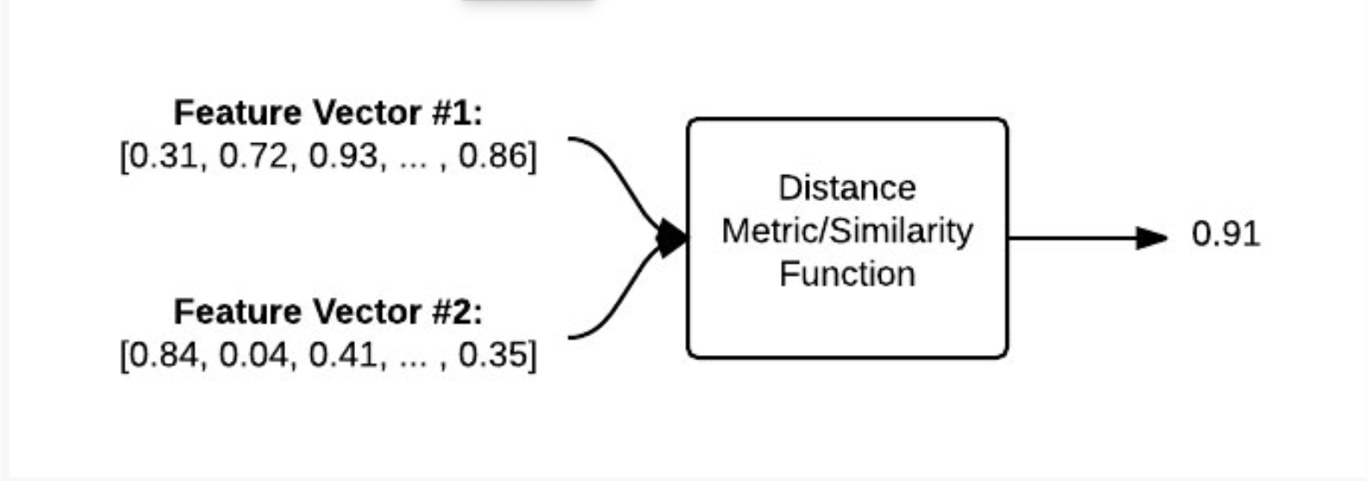
Comparison of Similarity

Slide 9
HSV descriptor
Color | Angle
Red | 0–60
Yellow | 60-–20
Green | 120–180
Cyan | 180–240
Blue | 240–300
Magenta | 300–360
HSV descriptor is a 3D color descriptor which is conceptually a 3D histogram in the HSV color space (Hue, Saturation and Value).
Hue is the color part of the model, represented as a number from 0 to 360 degrees:
We convert our image from RGB to HSV

Slide 10
Saturation
Saturation is the amount of gray in the color, from 0 to 100 percent. Decreasing the saturation toward zero to introduce more gray produces a faded effect.
Saturation is expressed in a range from just 0-1, where 0 is gray and 1 is a primary color.

Slide 11
Value (or Brightness)
Value represents the intensity of light or brightness where 0 is black and 100 is the brightest and results in the max color.

Slide 12
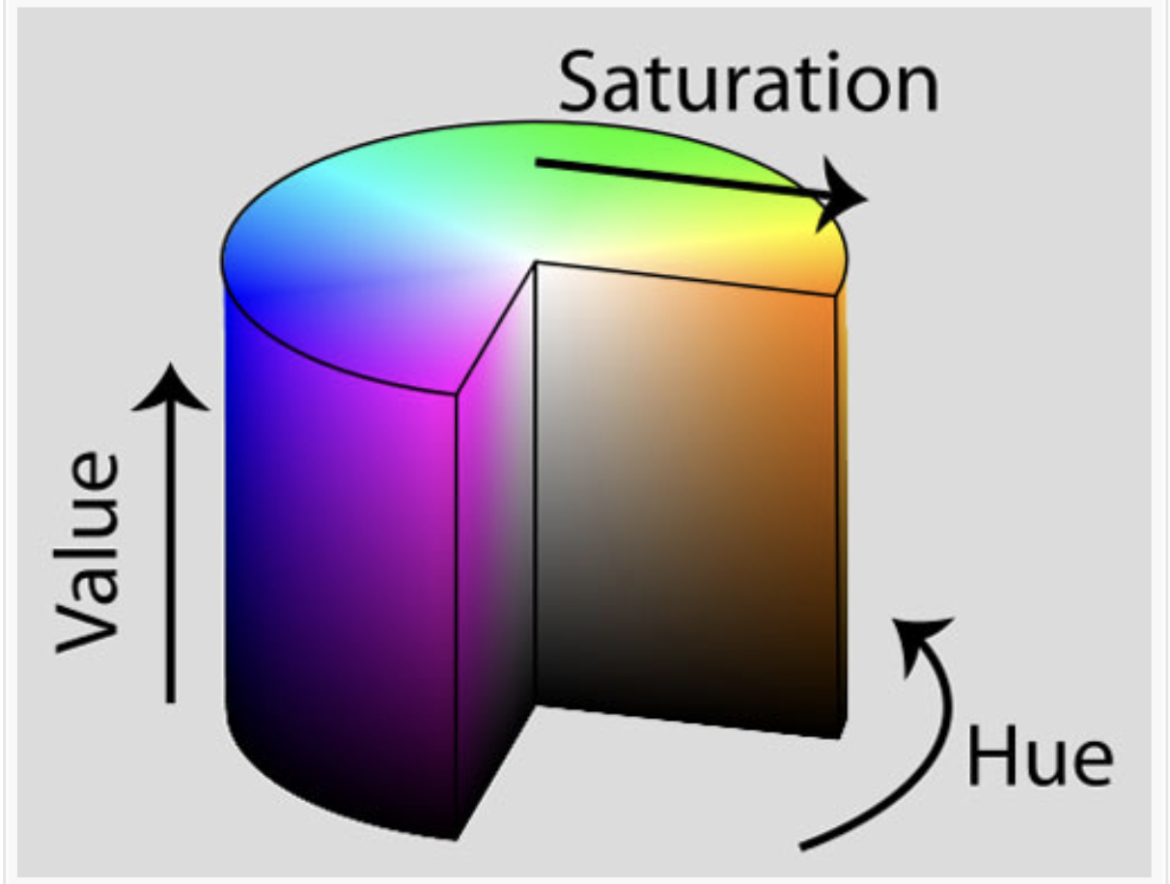

Slide 13
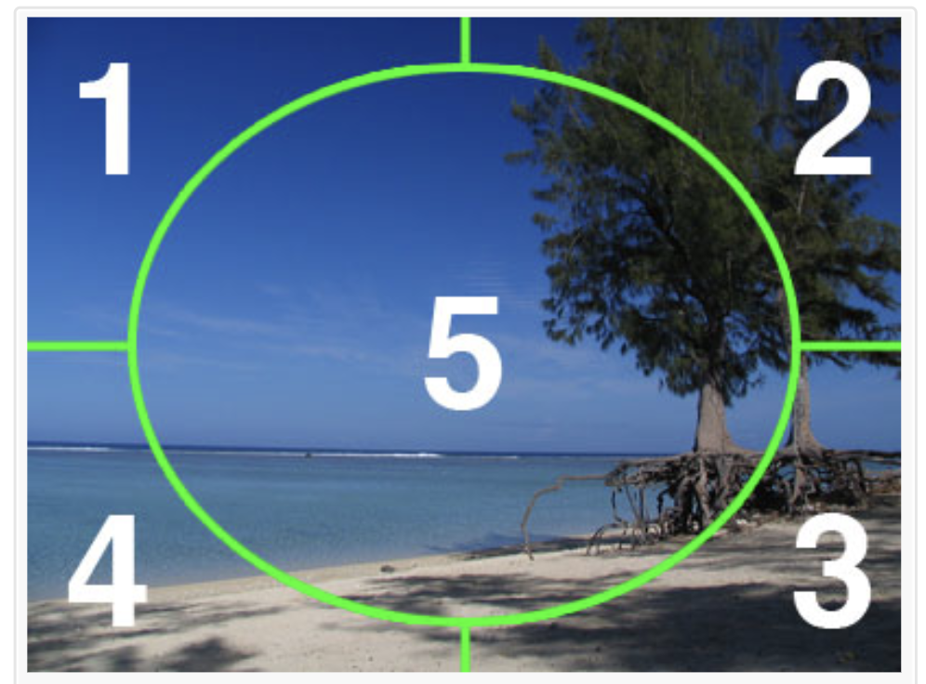
Histogram descriptor for our image
The image into 5 segments and calculate the histograms for them.
Hence we use a 3D color histogram with 8 hue channels, 12 Saturation and 3 Brightness Channels.
8x12x3=288 bins
288x5 =1440 features

Slide 14
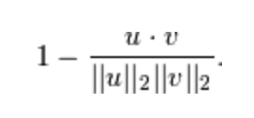
Similarity measures
Chi-Square :
(a - b)^2/(a + b)
Cosine distance:

Slide 15
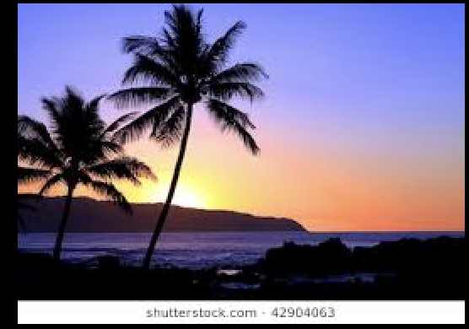
Results:
Query Image

Slide 16
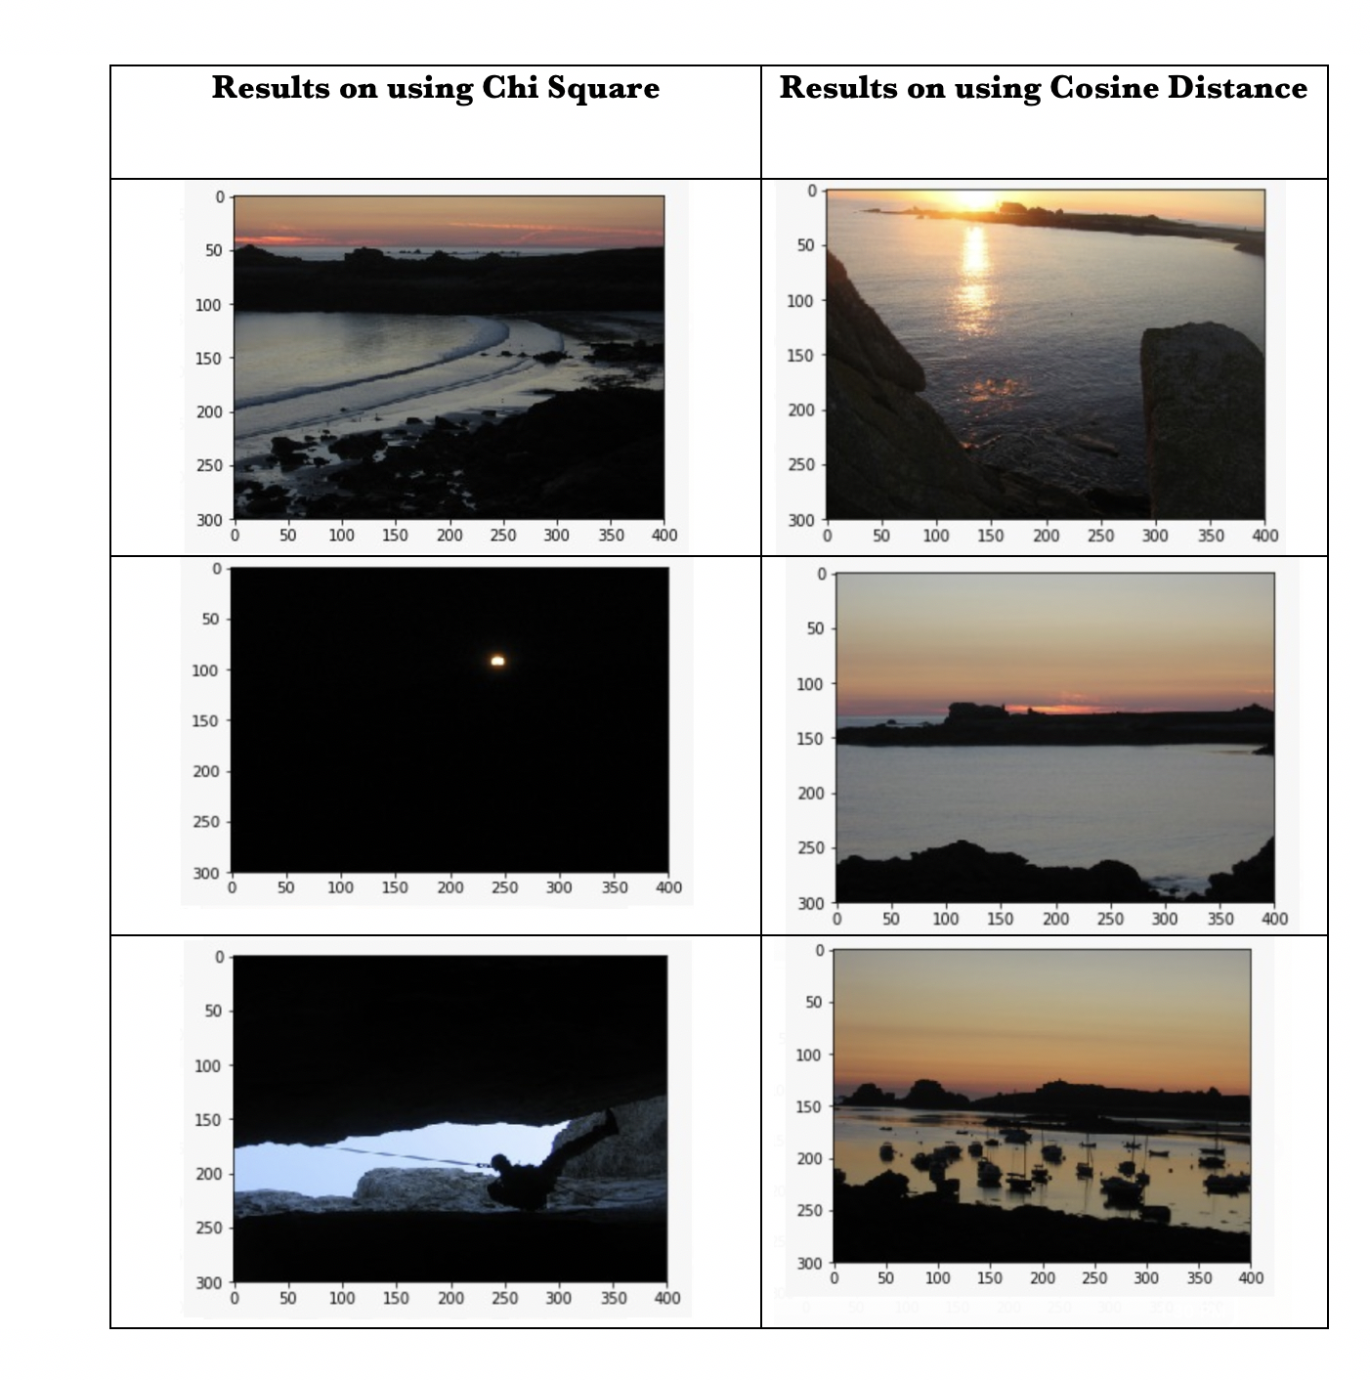
Results

Slide 17
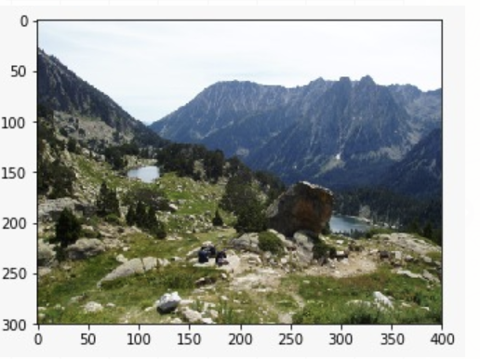
Results:
Query Image

Slide 18
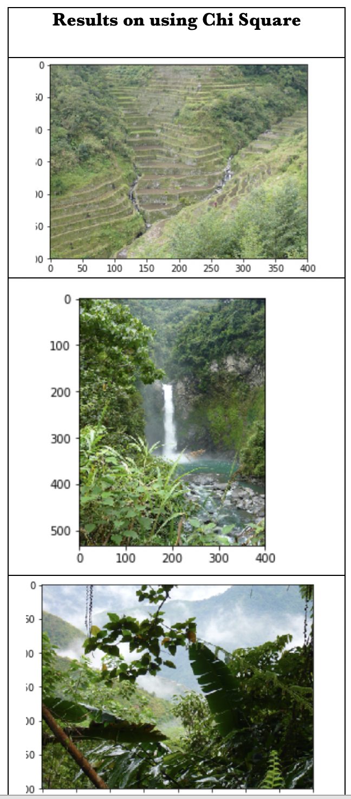

Slide 19
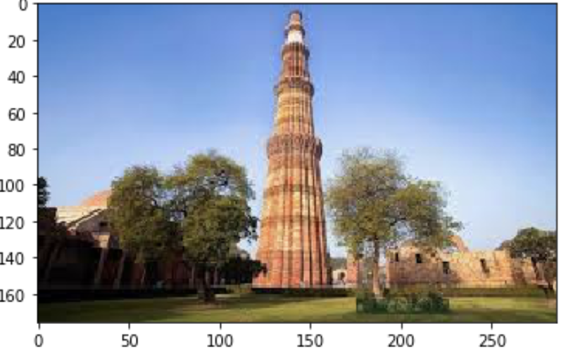
Results:
Query Image

Slide 20
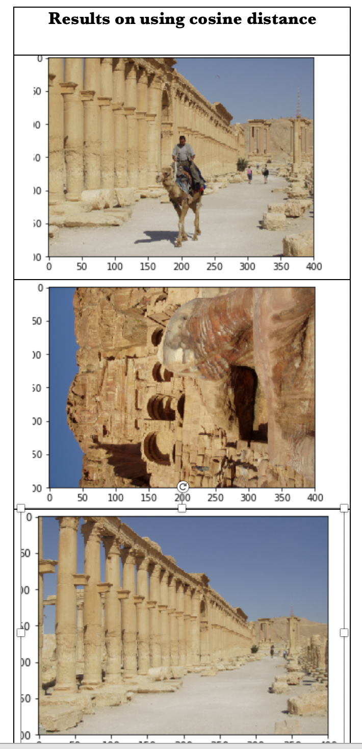

Slide 21
KAZE
There are many algorithms for feature extraction, most popular of them are SURF, ORB, SIFT, BRIEF. Most of this algorithms based on image gradient. Since these are not available for free anymore we used KAZE descriptor which gives similar results to SIFT.
KAZE is a Japanese word that means wind. Wind is the flow of air on a large scale who’s flow is ruled by nonlinear processes.

Slide 22
Nonlinear Diffusion Filtering
Nonlinear diffusion approaches depict the luminance of an image through increasing scale levels as the divergence of a certain flow function that controls the diffusion process. Nonlinear partial differential equations (PDEs) are used due to the nonlinear nature of the involved differential equations that diffuse the luminance of the image through the nonlinear scale space.

Slide 23
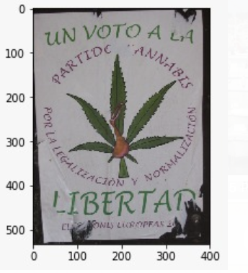
Results
Query Image

Slide 24
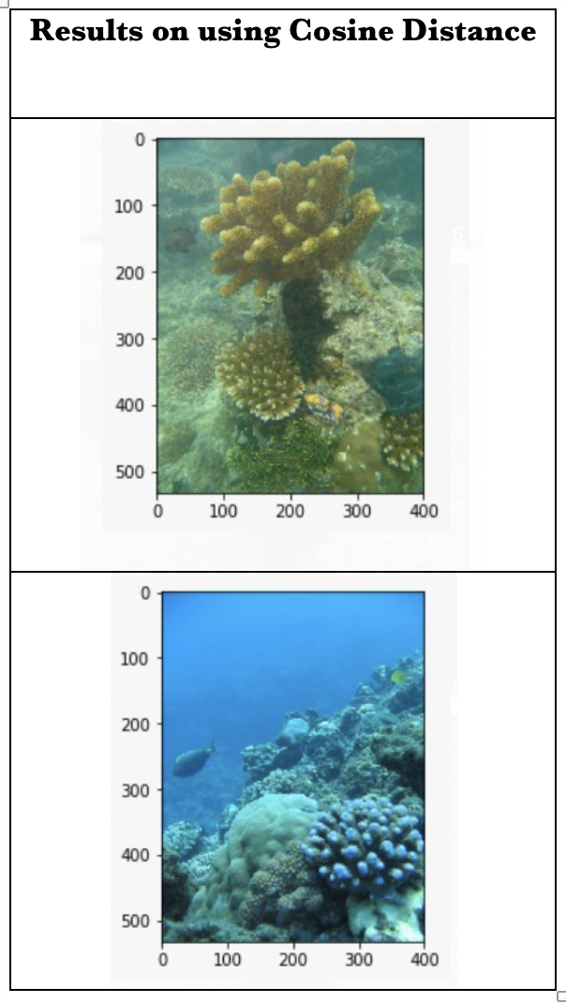

Slide 25
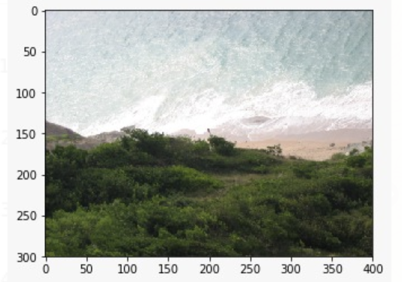
Results
Query Image

Slide 26
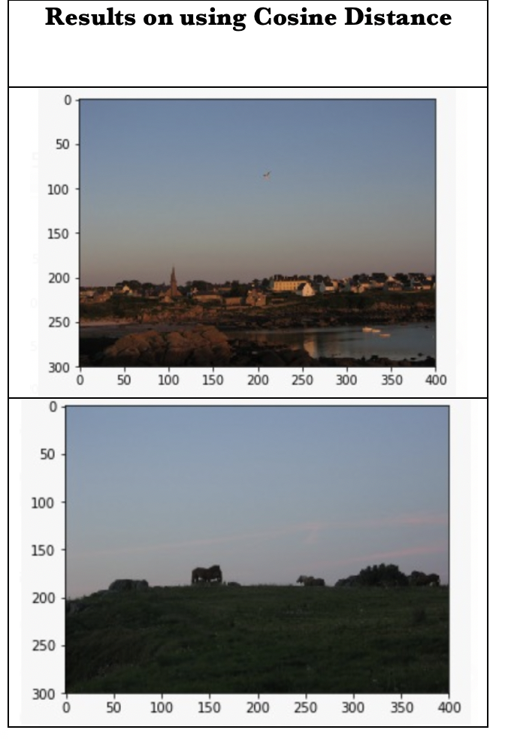

Slide 27
Possible Improvements
and future work
Evaluation Metrics to understand which algo works best
Use more distance measures such as Intersection, Correlation coefficient and also understand linear vs non-linear descriptors
Using other descriptors like SIFT, SURF & ORB.
Using a bigger dataset and compute cosine distance efficiently using Annoy Index (which speeds up cosine distance considerably). 1 million images can be searched in just 2ms.

